Slide 1
MOVIE RECOMMENDATION SYSTEM
Team members:
Amit Dilip Kini
Ashini Anantharaman
Niranjana Sathish Avilery
Praveen Chandrasekaran
Vigneshwaran Ravichandran
Professor: Dr. Nidhi Rastogi
Fall 2021 – December 7th, 2021

Slide 2
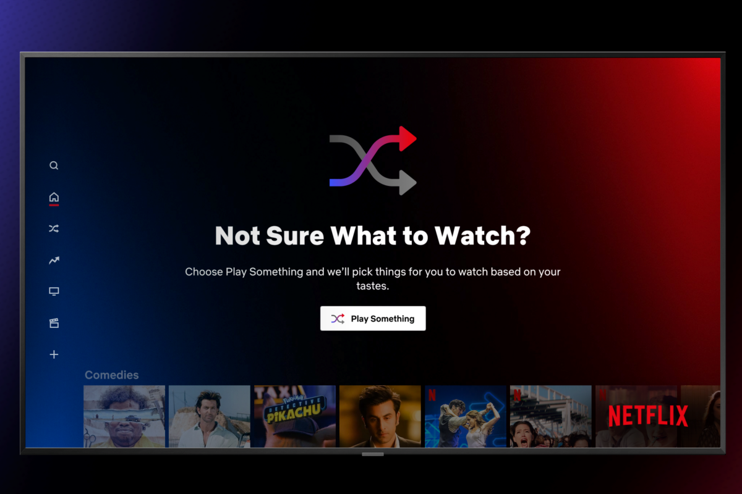
THE MOTIVATION
A stat* from 2017 shows that viewers spent 51 mins per day searching for shows to watch.
The OTT entertainment industry is a 129 billion** USD business in 2021 and is estimated to be doubled by 2026.
*ericsson.com, ‘TV and Media 2017’. https://www.ericsson.com/en/reports-and-papers/consumerlab/reports/tv-and-media-2017.
**statista.com, ‘OTT video revenue worldwide from 2010 to 2026’. https://www.statista.com/statistics/260179/over-the-top-revenue-worldwide
RIT | MS Data Science | Fall 2021 | DSCI 633 | Final Project

Slide 3

THE PROCESS
Identifying the Dataset
Data Pre-processing
Exploratory Data Analysis
Identifying and Building the ML models
Data Validation and Movie Recommendation
RIT | MS Data Science | Fall 2021 | DSCI 633 | Final Project

Slide 4
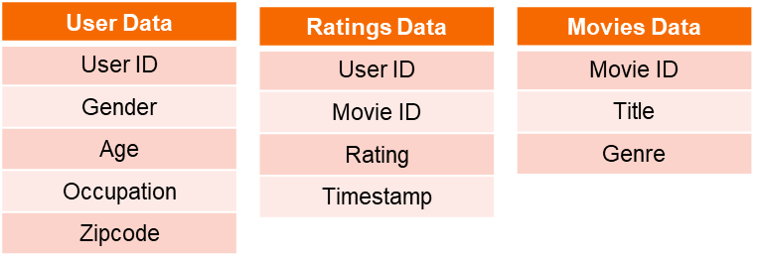
THE GROUPLENS DATASET
6040
Users
3883 Movies
Features in the dataset
1 M+ User Ratings
https://grouplens.org/datasets/movielens/1m/
RIT | MS Data Science | Fall 2021 | DSCI 633 | Final Project

Slide 5
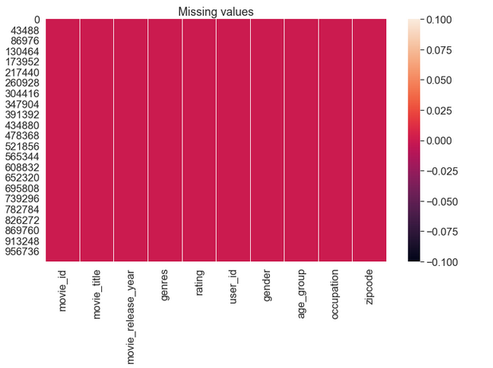
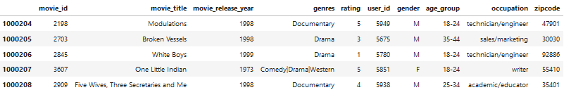
DATA PRE-PROCESSING
No Missing Values
The Merged Dataframe
RIT | MS Data Science | Fall 2021 | DSCI 633 | Final Project

Slide 6
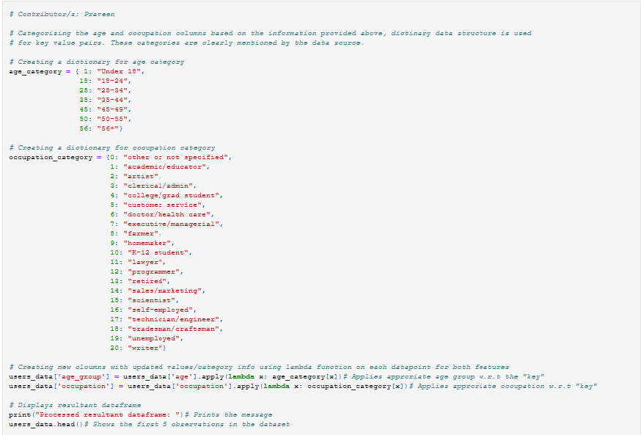
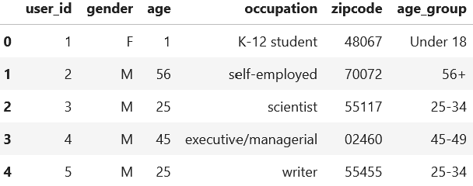
DATA PRE-PROCESSING CONTD…
RIT | MS Data Science | Fall 2021 | DSCI 633 | Final Project

Slide 7
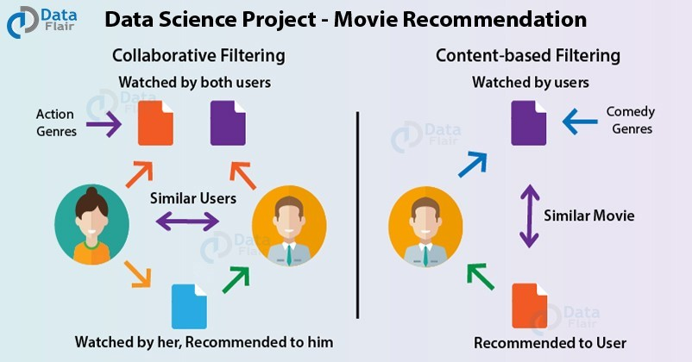
TYPES OF RECOMMENDATION SYSTEM MODELS
Content-based Filtering
Collaborative Filtering
RIT | MS Data Science | Fall 2021 | DSCI 633 | Final Project

Slide 8
TOP QUESTIONS FROM BRAINSTORMING
Do science fiction movies tend to be rated more highly than other movie genres?
Which genres were more dominant in each decade of the range available in the dataset?
Is there a correlation between the year of release of a movie and the genre?
What are the top 10 most rated movies?
What are the most popular Movie Genres among Males and Females?
What are the Max/Min number of Movies rated by One user?
What Genre is associated with the most Movies?
What are the Distribution of Ratings per Genre?
Most common occupation amongst the users
What’s the Age Distribution by Gender?
Movies are rated on a 1-5 scale. What is the average movie rating?
How many of the users are artists or belong to or closely related to the film industry?
What is the zip code of the user who rated the most movies?
What interesting stories using the data in Movielens dataset you would like to tell a studio executive/movie producer?
RIT | MS Data Science | Fall 2021 | DSCI 633 | Final Project

Slide 9
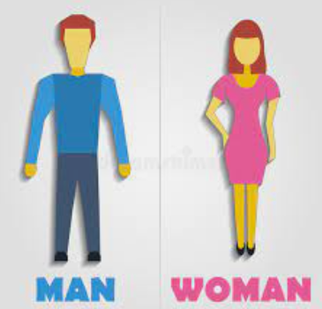

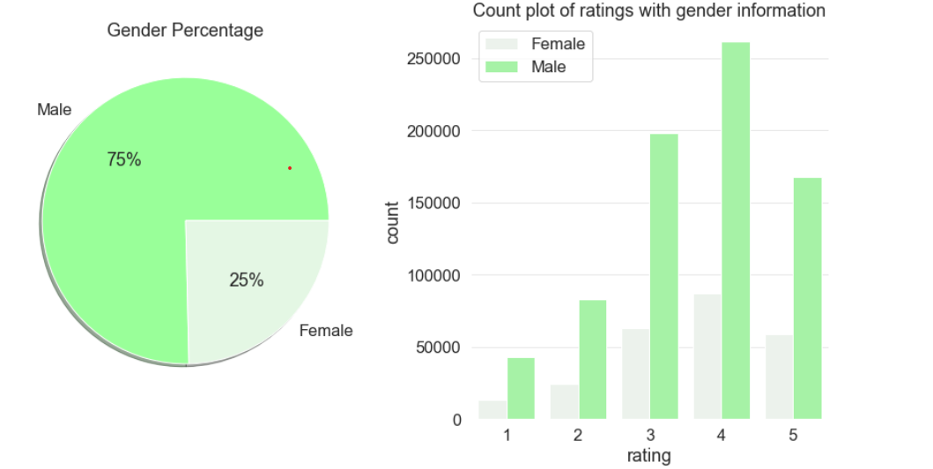

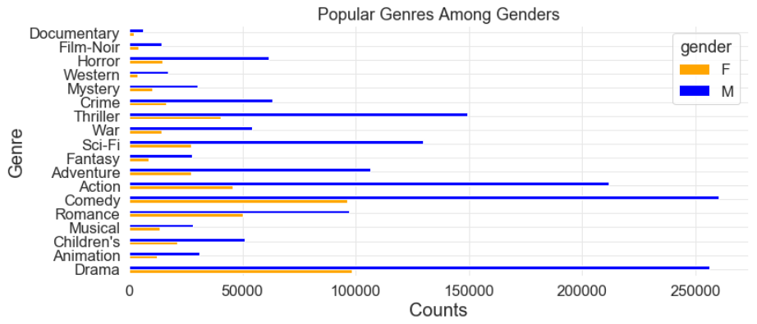
GENDER ANALYSIS
Ratings Distribution
Observation - I
Gender are not equally distributed among the two categories.
It can be inferred that most of the ratings were given by the male category (75%).
4 is the most common rating given by both genders.
Since fewer females rated these movies, the ratings data could be biased.
Genre preferences
Observation - II
Male most rated movie is Comedy and second most rated is Drama.
Female most rated movie is Drama and second most rated is Comedy.
On the least choice it was similar for both the gender which is Documentary and film noir.
RIT | MS Data Science | Fall 2021 | DSCI 633 | Final Project

Slide 10
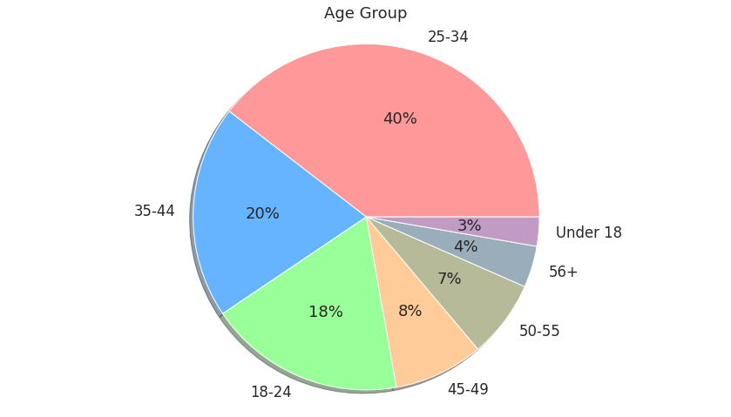
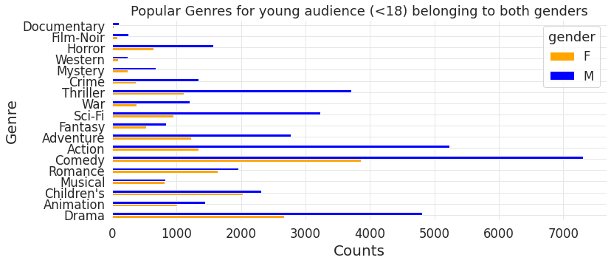
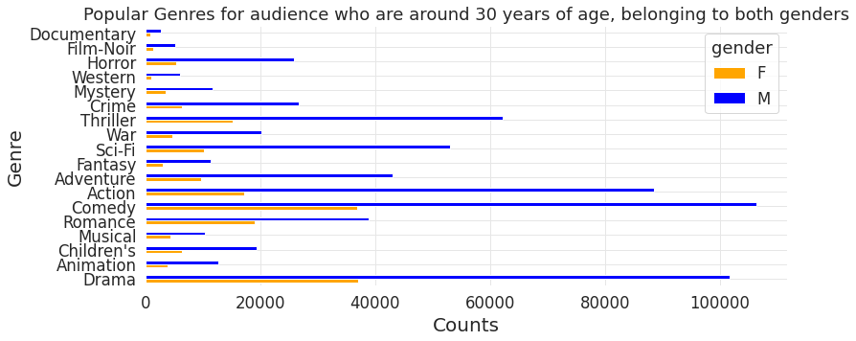
GENRE ANALYSIS
Distribution of Age
Genre distribution for younger audience
Genre distribution around age 30
Observation - I
Observation - II
Observation - III
Our most rated age people were around 25-34 age (40 %) and the least being the people under 18 ages ( 3% ) .
In Observation – II & III the most rated and least rated are being compared.
Most popular genre for the teens and kids is Comedy.
Next popular genre is Action among the male and Drama for the female category.
The rating of people around 30 age which being the top two rated movies are Comedy and Drama and least watched are Documentary and Film noir for both the group.
RIT | MS Data Science | Fall 2021 | DSCI 633 | Final Project

Slide 11
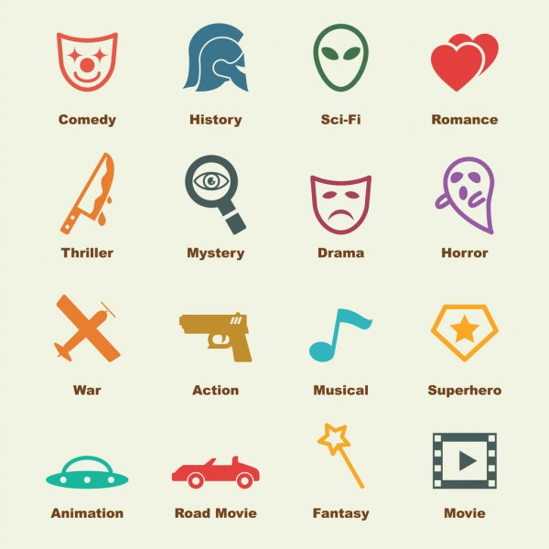
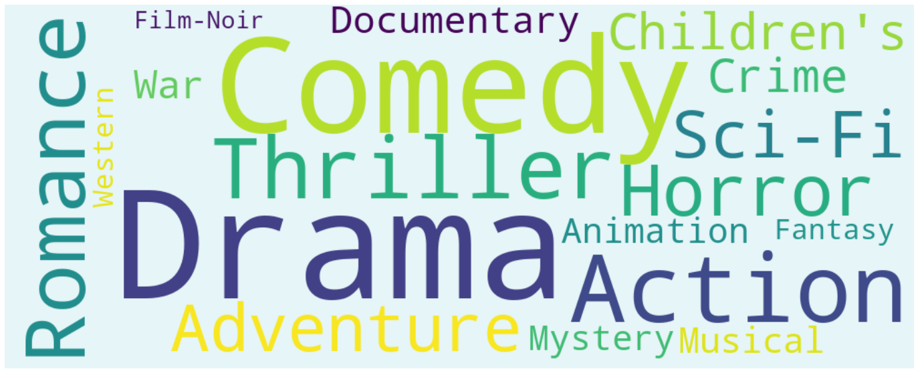
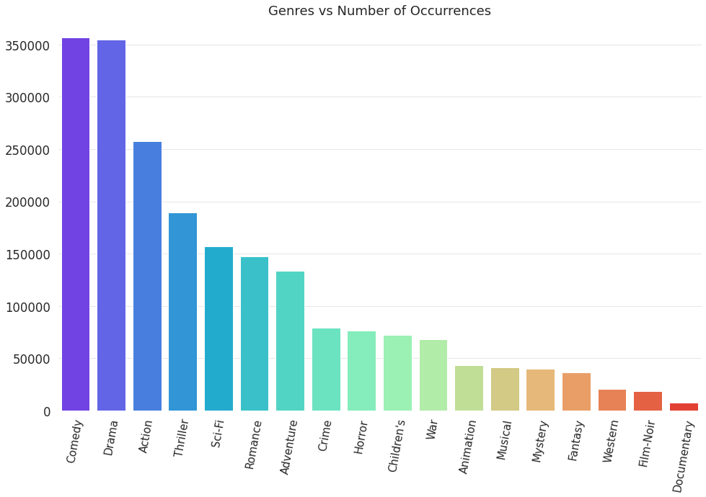
GENRE ANALYSIS CONTINUED
Popular genre categories
Observation
We can see that Comedy, Drama, Action and Romance displayed bigger words showing it is being rated most and War, Film-noir and documentary displayed in small as it is being rated less.
Number of occurences in each genre
Number of occurrences of genre is displayed in the bar graph also shows that the Comedy, Drama being the most rated movie and film noir & documentary being the least.
RIT | MS Data Science | Fall 2021 | DSCI 633 | Final Project

Slide 12
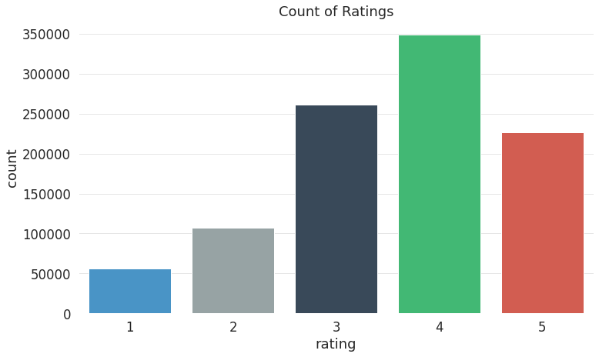
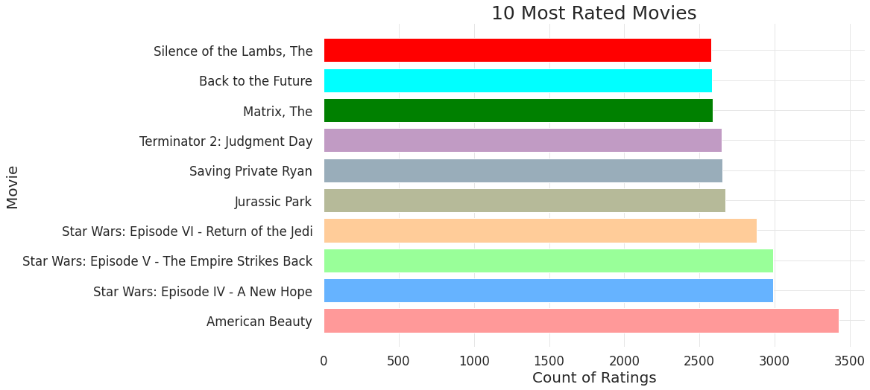
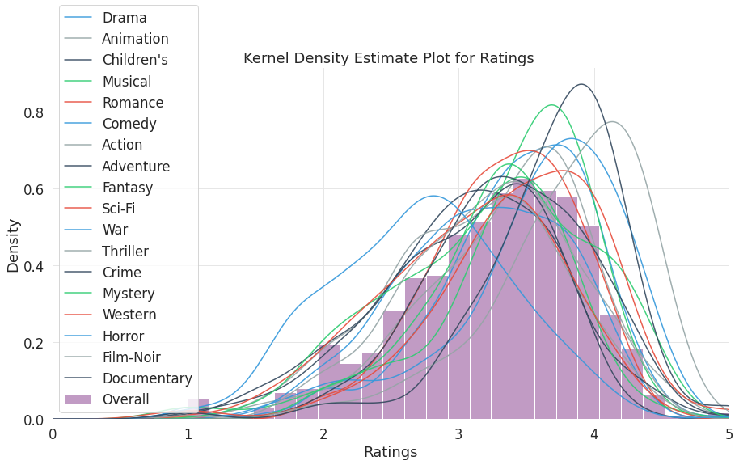
RATING ANALYSIS
Distribution
Top Movies
Density Estimate Plot
Observation - I
Observation - II
Observation - III
All age user their rating on movie is positive (4 star) contributing 35%.
Next most rated on movies stay on neutral (3 star) ground contributing 26%.
Most popular genre in the top 10 most rated movies based on the number of ratings falls in the Action and Sci-fi category.
We can see left-skewed for most genres, except for the war-based movies that has mixed ratings. This is the example that people rate movies based on their likes.
RIT | MS Data Science | Fall 2021 | DSCI 633 | Final Project

Slide 13

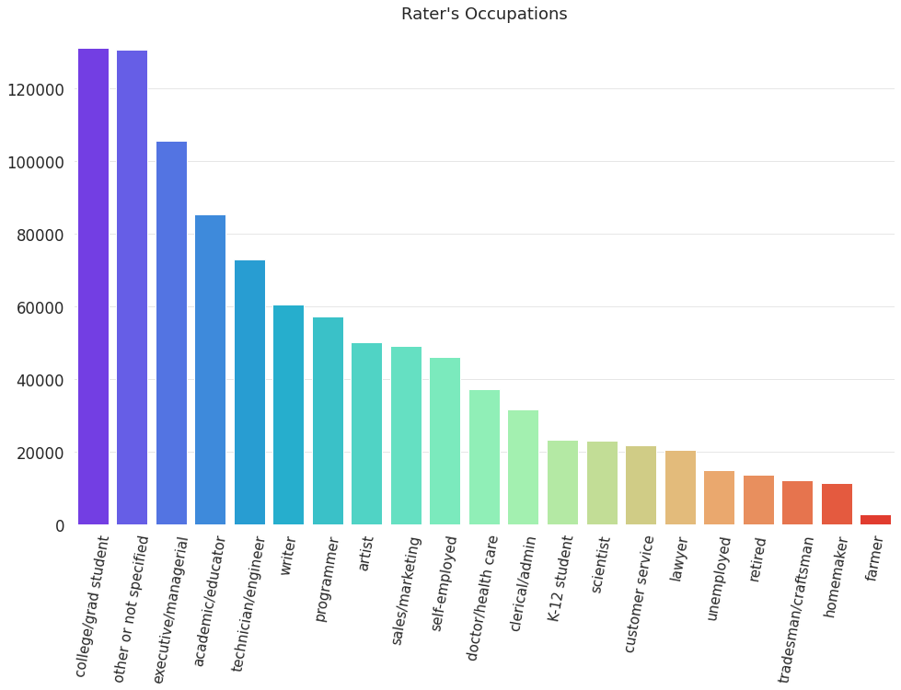
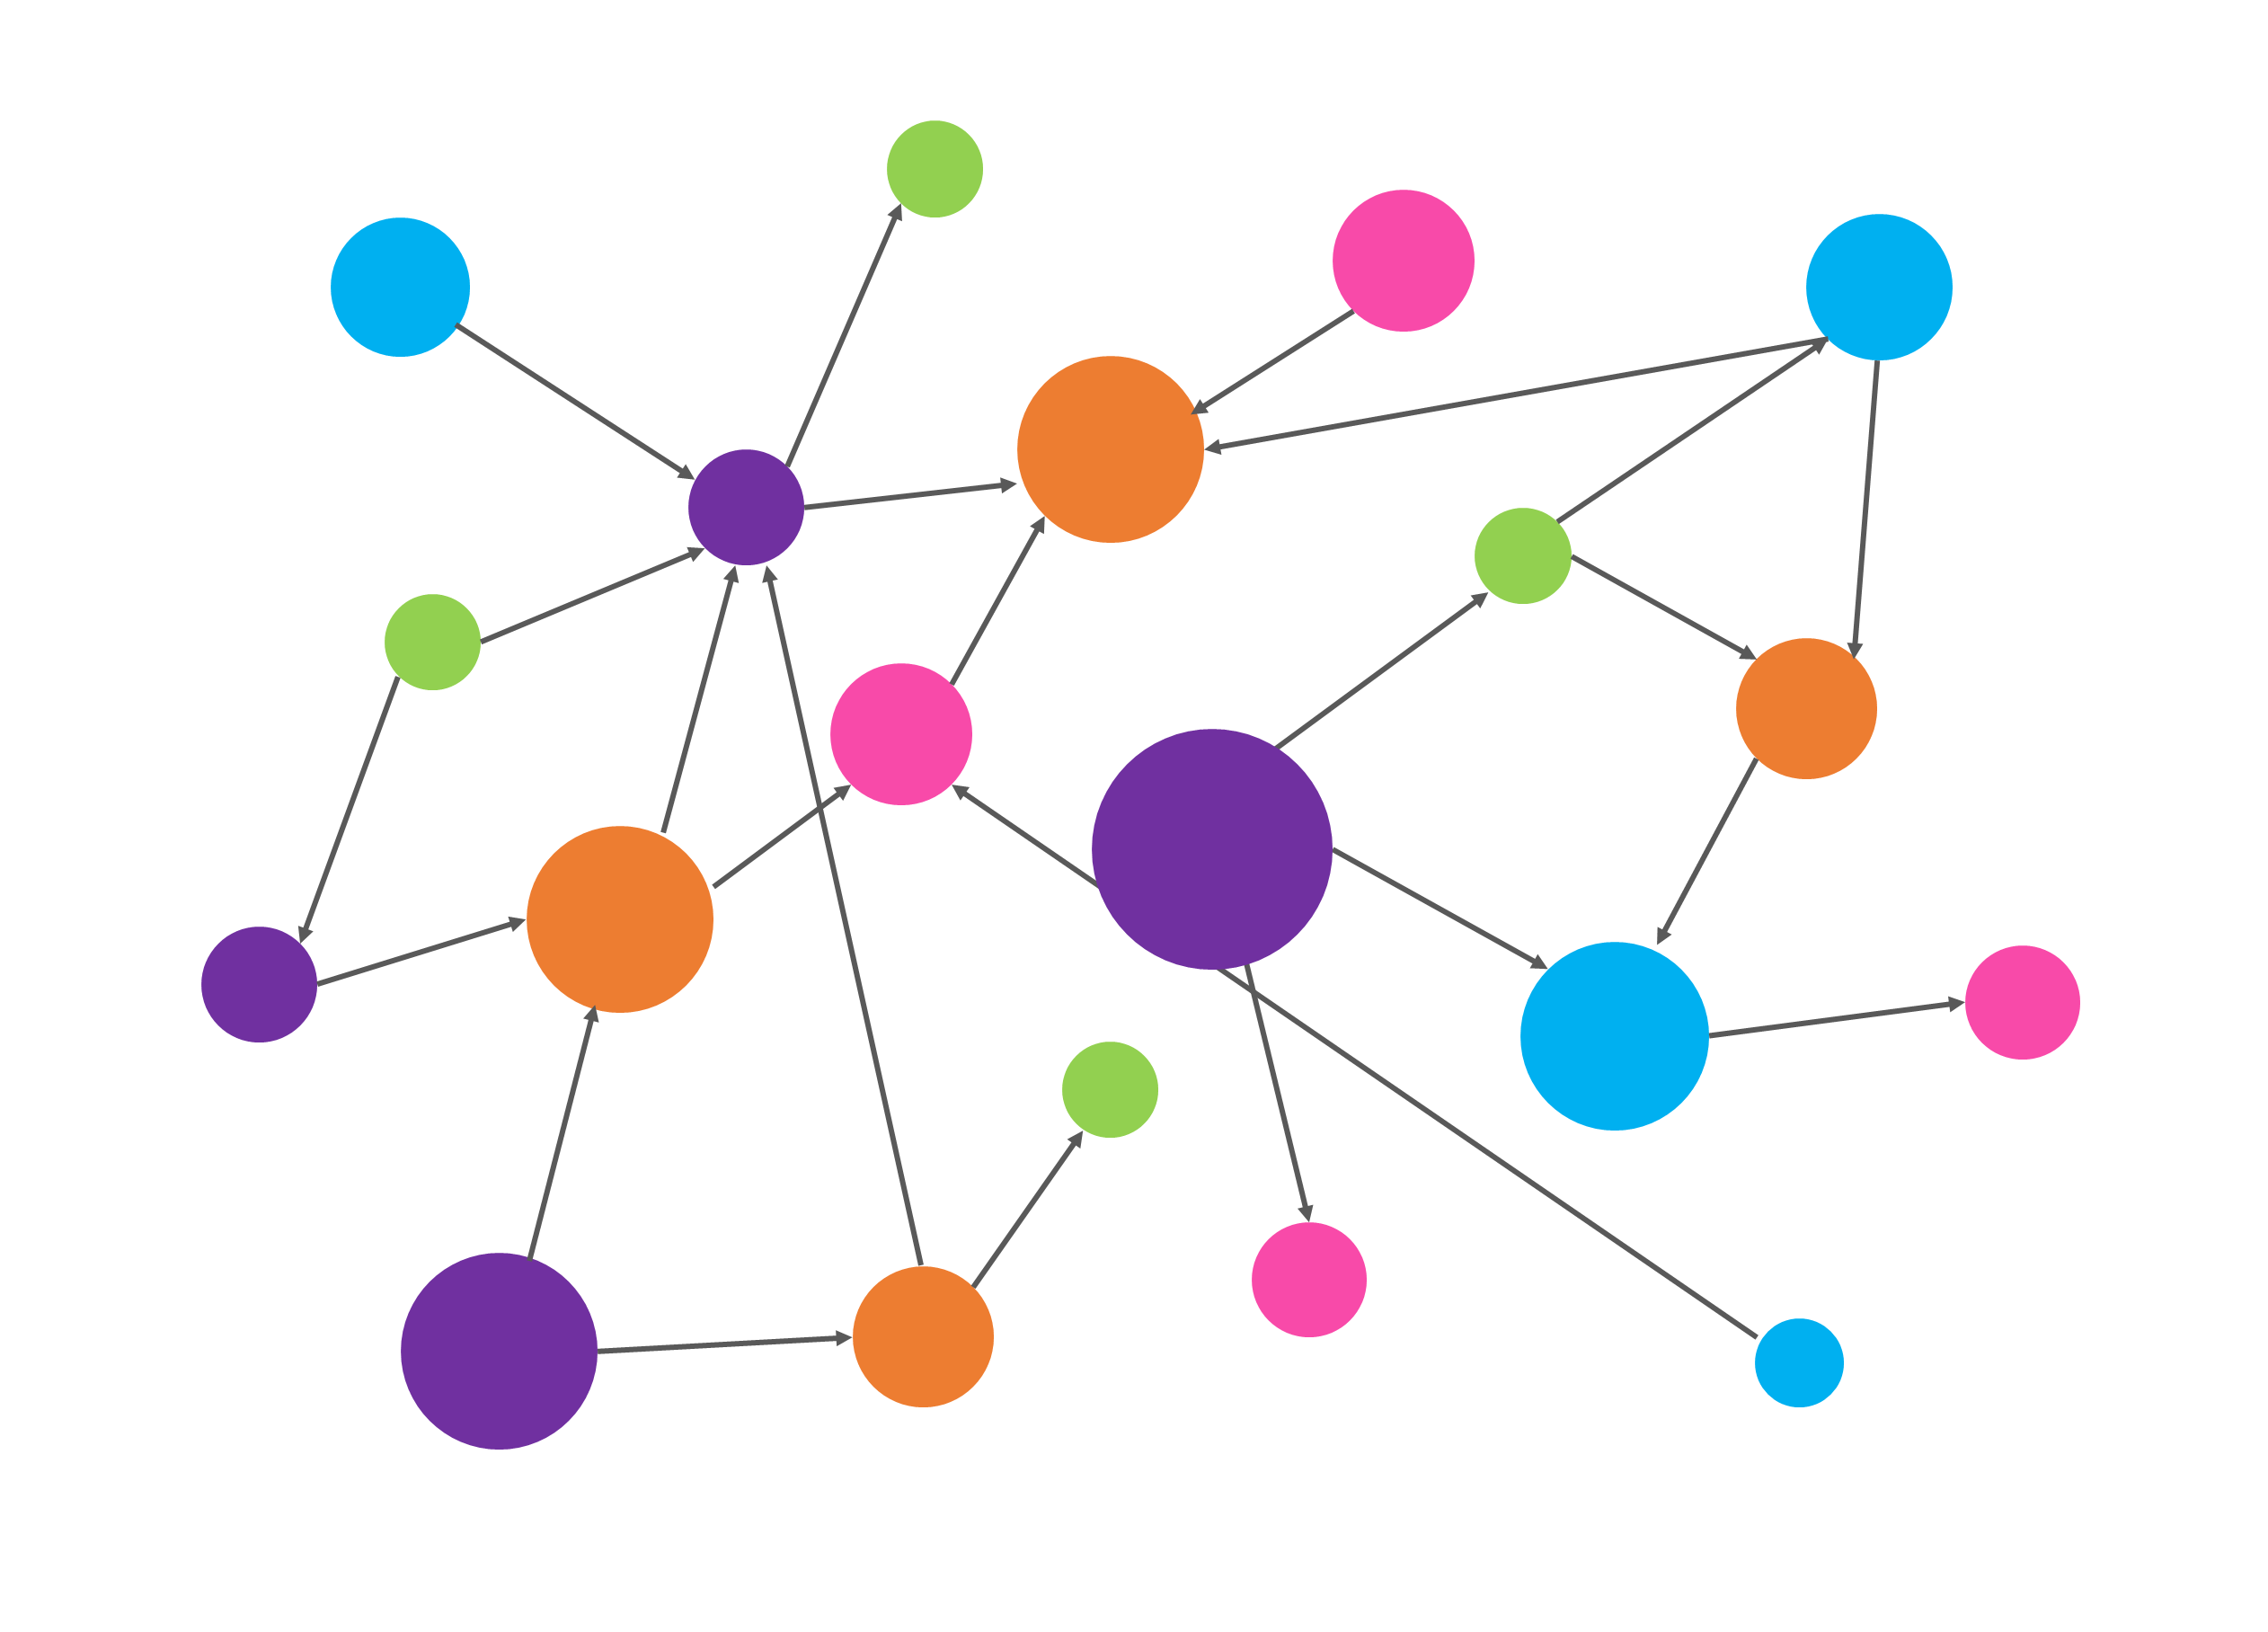
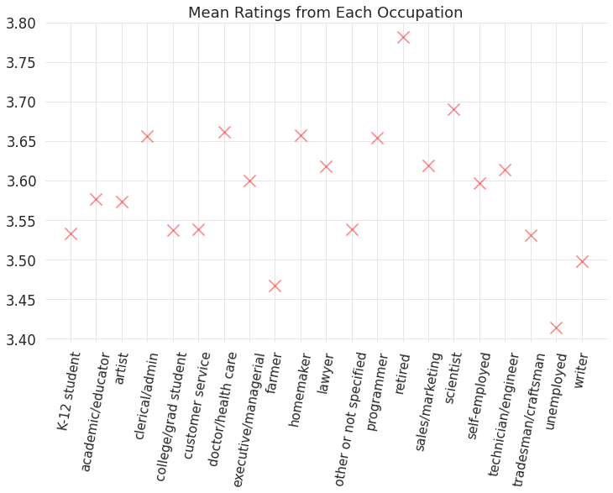
OCCUPATION ANALYSIS
Number of ratings
Observation - I
Comparing the Occupation of the rater’s we found out the obvious result of College / Grad Student being the most rating user and the least being the farmers.
Average rating
Observation - II
Average rating is the highest for the retired community even though the count of ratings provided is not much.
Student community being the highest contributor of ratings has a mean rating of around 3.55.
Data unequally distributed based on occupation.
RIT | MS Data Science | Fall 2021 | DSCI 633 | Final Project

Slide 14
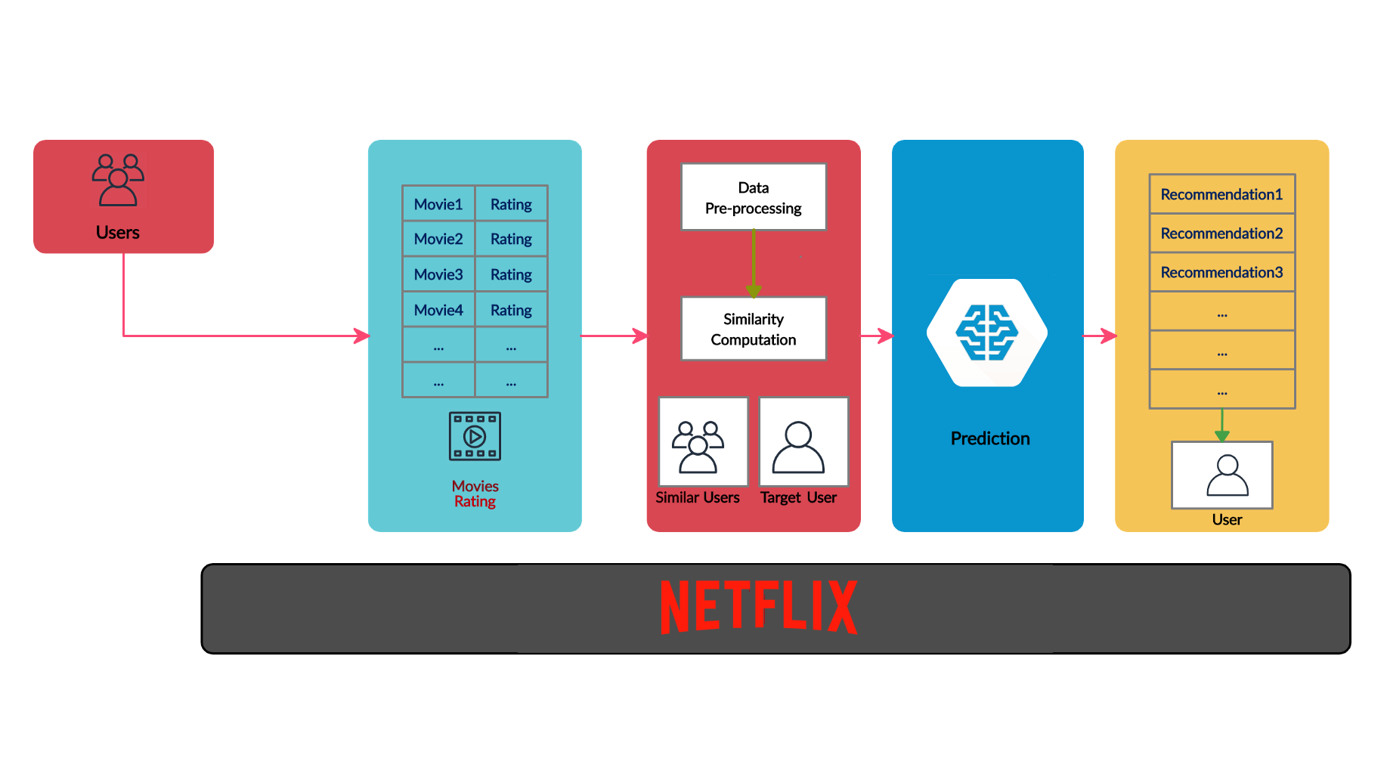
| 14
RECOMMENDATION SYSTEMS EXPLORED
What is a recommendation system??
Main purpose of the recommendation system is to suggest
relevant items to users based on the user’s interest and the past preference.
Process of a recommendation system
RIT | MS Data Science | Fall 2021 | DSCI 633 | Final Project

Slide 15
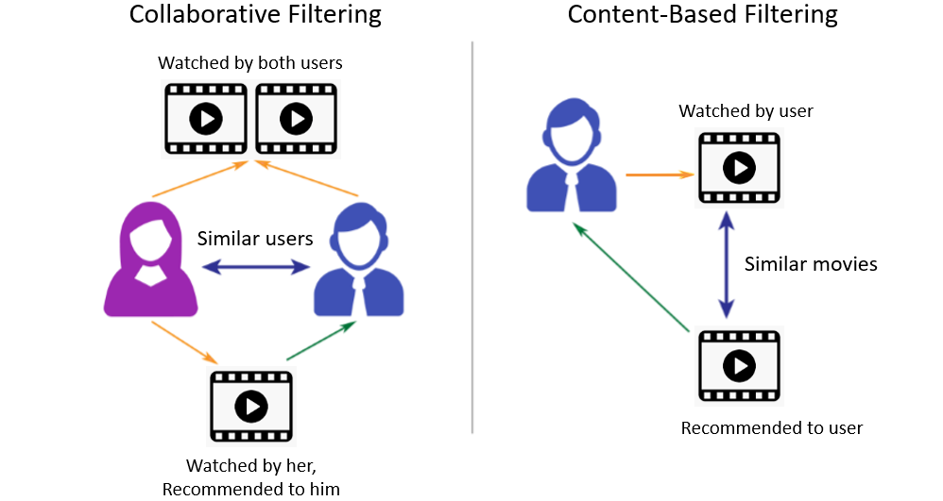
| 15
TYPES OF FILTERING
Our 1st approach – C.B
Our 2nd approach – C.F
Content-based recommender learns a profile of the new user’s interests based on the features present in the objects the user has rated.
In a content-based recommender system the algorithms used are such that it recommends users, similar items that the user has liked in the past or is examining currently.
Collaborative recommender systems aggregates ratings or recommendations of objects, recognize commonalities between the users in the basis of their ratings, and generate new recommendations based on inter-user comparisons.
RIT | MS Data Science | Fall 2021 | DSCI 633 | Final Project

Slide 16


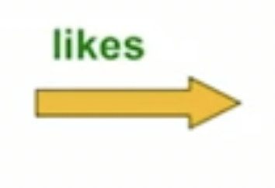

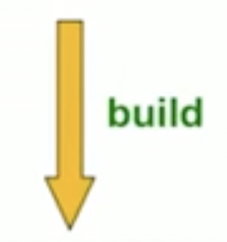



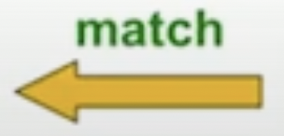

| 16
CONTENT-BASED RECOMMENDATION PROCESS
Normalize Ratings
Make Predictions
Create the user profile
Recommendation
Create the item profile
RIT | MS Data Science | Fall 2021 | DSCI 633 | Final Project

Slide 17
BUILD ITEM PROFILE
| 17
An item profile is the set of features of each item.
ACTORS
It is convenient to think of an item profile to be a vector rather than set of features.
Vector may be real-valued or Boolean with one entry per feature.
In our case genre is the feature which is used (text), hence TF – IDF comes into play.
ITEM PROFILE FOR MOVIES
GENRES
DIRECTORS
RIT | MS Data Science | Fall 2021 | DSCI 633 | Final Project

Slide 18

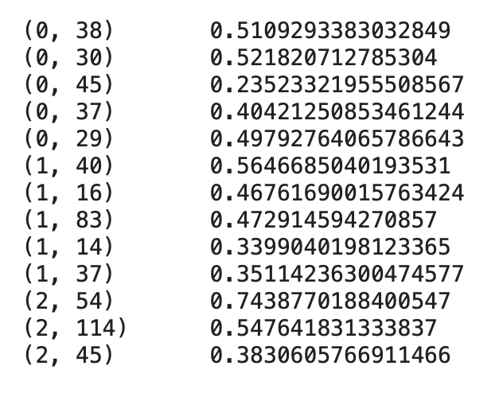
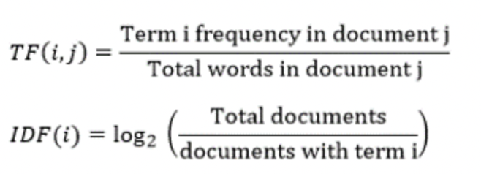
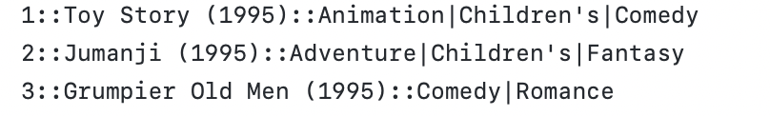
TF – IDF SCORE FOR GENRES
| 18
The TF – IDF scores for first 3 movies
FIRST 3 MOVIE
RIT | MS Data Science | Fall 2021 | DSCI 633 | Final Project
Notes:
How to calculate the important genres of the movie?

Slide 19
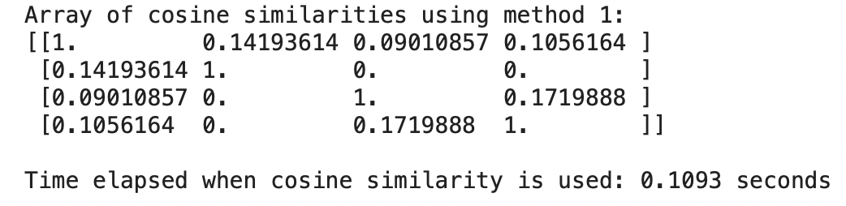
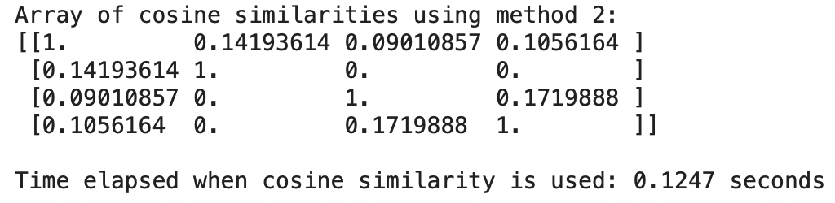
CALCULATE SIMILARITY
| 19
Cosine Similarity
Linear Kernel
RIT | MS Data Science | Fall 2021 | DSCI 633 | Final Project

Slide 20
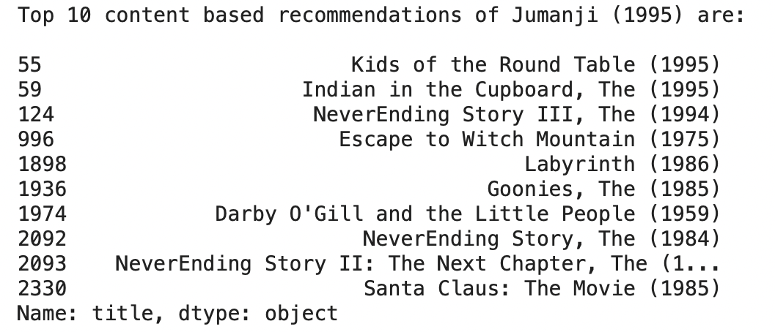
FINAL RECOMMEDATIONS MADE
| 20
JUMANJI - (Adventure|Children's|Fantasy)
Adventure|Children's|Fantasy
Adventure|Children's|Fantasy
Adventure|Children's|Fantasy
Adventure|Children's|Fantasy
Adventure|Children's|Fantasy
Adventure|Children's|Fantasy
Adventure|Children's|Fantasy
Adventure|Children's|Fantasy
Children's|Comedy|Fantasy
RIT | MS Data Science | Fall 2021 | DSCI 633 | Final Project

Slide 21
| 21
PROS AND CONS OF CONTENT BASED RECOMMENDATION SYSTEM
PROS
CONS
No need for data on other users
Recommendation to users with unique taste
Ability to recommend new and unpopular items
Provides explanation to the user as to why this item was recommended
Finding the appropriate feature is hard
Never recommends outside user’s content profile
Challenging to create a new user profile
RIT | MS Data Science | Fall 2021 | DSCI 633 | Final Project

Slide 22
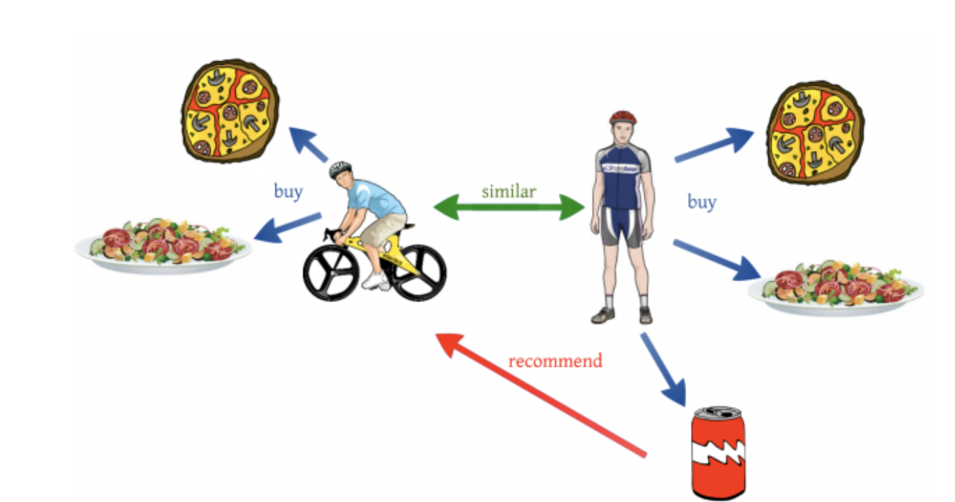
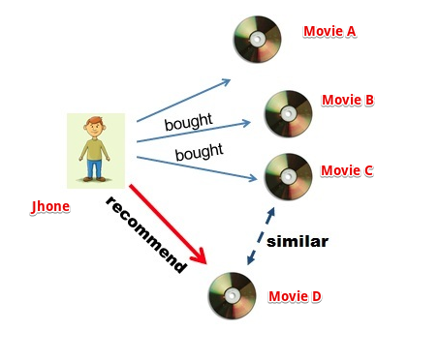
COLLABORATIVE-BASED RECOMMENDATION SYSTEM
Memory-based Collaborative filtering
User-based
Item-based
RIT | MS Data Science | Fall 2021 | DSCI 633 | Final Project

Slide 23



USER-USER COLLABORATIVE-BASED RECOMMENDATION SYSTEM
Similar users
User X
N users
Search
Search
Database
Database
prefer
Recommendation
Recommended movies
RIT | MS Data Science | Fall 2021 | DSCI 633 | Final Project

Slide 24
TO FIND SIMILAR USERS
 | Spider-Man: No Way Home | Spider-Man: Far From Home | Doctor Strange | Friday the 13th | Monster House | Madagascar: Escape 2 Africa | Toy Story
User A | 4 |  |  | 5 | 1
User B | 5 | 5 | 4
User C |  |  |  | 2 | 4 | 5
User D |  | 3 |  |  |  |  | 3
Consider users A and B with rating vector rA and rB
We need a similarity metric sim(x,y)
Capture intuition that sim(A,B) > sim(A,C)
RIT | MS Data Science | Fall 2021 | DSCI 633 | Final Project

Slide 25
APPROACH 1: JACCARD SIMILARITY
 | Spider-Man: No Way Home | Spider-Man: Far From Home | Doctor Strange | Friday the 13th | Monster House | Madagascar: Escape 2 Africa | Toy Story
User A | 4 |  |  | 5 | 1
User B | 5 | 5 | 4
User C |  |  |  | 2 | 4 | 5
User D |  | 3 |  |  |  |  | 3
sim(A,B) = |rA ∩ rB| / |rA ∪ rB|
sim(A,B) = 1/5; sim(A,C) = 2/4
sim(A,B) < sim(A,C)
Ignores rating values
RIT | MS Data Science | Fall 2021 | DSCI 633 | Final Project

Slide 26
APPROACH 2: COSINE SIMILARITY
 | Spider-Man: No Way Home | Spider-Man: Far From Home | Doctor Strange | Friday the 13th | Monster House | Madagascar: Escape 2 Africa | Toy Story
User A | 4 |  |  | 5 | 1
User B | 5 | 5 | 4
User C |  |  |  | 2 | 4 | 5
User D |  | 3 |  |  |  |  | 3
sim(A,B) = cos(rA,rB)
sim(A,B) = 0.38; sim(A,C) = 0.32
sim(A,B) > sim(A,C), but not by much
Treats missing ratings as negative
RIT | MS Data Science | Fall 2021 | DSCI 633 | Final Project

Slide 27
APPROACH 3: PEARSON COEFFICIENT (OR) CENTERED COSINE SIMILARITY
 | Spider-Man: No Way Home | Spider-Man: Far From Home | Doctor Strange | Friday the 13th | Monster House | Madagascar: Escape 2 Africa | Toy Story | Average
User A | 4 |  |  | 5 | 1 |  |  | 10/3
User B | 5 | 5 | 4 |  |  |  |  | 14/3
User C |  |  |  | 2 | 4 | 5 |  | 11/3
User D |  | 3 |  |  |  |  | 3 | 3
Normalize ratings by subtracting row mean
RIT | MS Data Science | Fall 2021 | DSCI 633 | Final Project

Slide 28
APPROACH 3: PEARSON COEFFICIENT (OR) CENTERED COSINE SIMILARITY
 | Spider-Man: No Way Home | Spider-Man: Far From Home | Doctor Strange | Friday the 13th | Monster House | Madagascar: Escape 2 Africa | Toy Story | Average
User A | 2/3 |  |  | 5/3 | -7/3 |  |  | 10/3
User B | 1/3 | 1/3 | -2/3 |  |  |  |  | 14/3
User C |  |  |  | -5/3 | 1/3 | 4/3 |  | 11/3
User D |  | 0 |  |  |  |  | 0 | 3
sim(A,B) = cos(rA,rB) = 0.09; sim(A,C) = -0.56
sim(A,B) > sim(A,C)
Captures intuition better
Missing ratings treated as “average”
Handles “tough raters” as “easy raters”
RIT | MS Data Science | Fall 2021 | DSCI 633 | Final Project

Slide 29
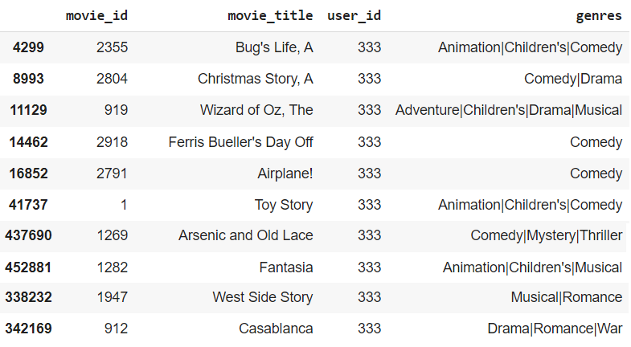
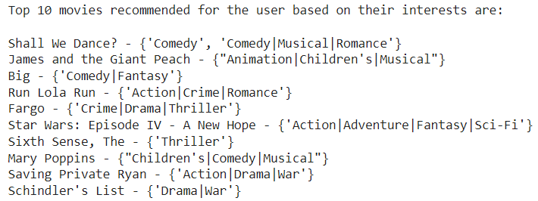
RESULTS OF USER-BASED COLLABORATIVE FILTERING
Sample data of movies rated ‘5’ by User 333
Movies recommended to User 333
RIT | MS Data Science | Fall 2021 | DSCI 633 | Final Project

Slide 30
PROS AND CONS OF USER-BASED COLLABORATIVE FILTERING
PROS
CONS
Greater diversity in the recommendation process.
Performance of user-based recommenders keeps improving (albeit very slightly) as neighborhood sizes are increased.
Sparsity: The percentage of people who rate items is really low.
Cold-start: New users will have no to little information about them to be compared with other users.
Scalability: The more users there are in the system, the greater the cost of finding the nearest K neighbors will be.
RIT | MS Data Science | Fall 2021 | DSCI 633 | Final Project

Slide 31
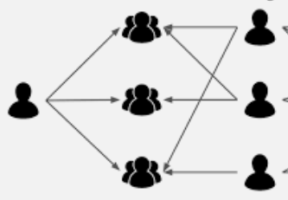

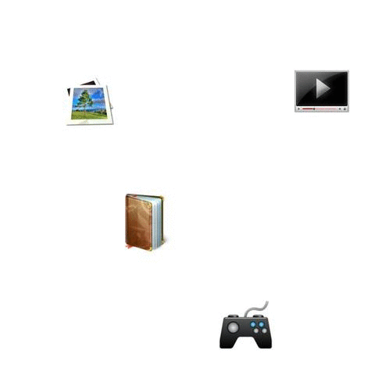
| 31
COLLABORATIVE FILTERING AGAIN!
Collaborative Filtering
Learnings
User – User Collaborative Filtering
Item – Item Collaborative Filtering
User – User Collaborative Filtering
Item – Item Collaborative Filtering
Collaborative filters are expected to increase diversity because they help us discover new products.
Collaborative filters help in bringing up personal recommendations unlike content based system
Collaborative filters help in bringing up personal recommendations unlike content based system
After implementing the recommendation system with a manual approach (which was very inefficient) we decided to implement an user type collaborative filtering with different approach
RIT | MS Data Science | Fall 2021 | DSCI 633 | Final Project

Slide 32
| 32
6 STEPS WERE CARRIED OUT IN THIS USER COLLABORATIVE 2ND APPROACH
1
2
3
Create an imaginary user who has watched and rated some movies, used as input data
Add movie ID to this imaginary input user
Based on his rating to movies, find the top X neighbors
4
5
6
Get the watched movie record of the user for each neighbor
Calculate a similarity score using Pearson
Correlation
Recommend the items with the highest score
RIT | MS Data Science | Fall 2021 | DSCI 633 | Final Project

Slide 33
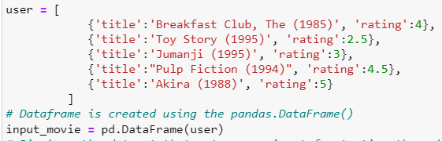
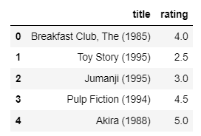
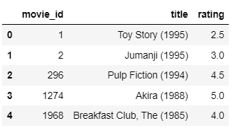
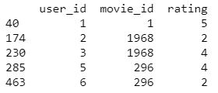
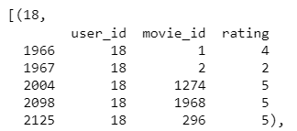
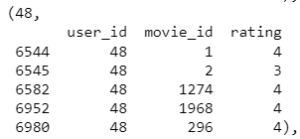
| 33
STEPS USED TO GENERATE THE DATA FRAME OF RECOMMENDATIONS
1
Input data without ID
2
3
Imaginary User as input
.isin() used to find the ID
No ID
Data with only “input” movie IDs along with user ID
4
5
Sorted groupedby user id who watched input movies
Sorted based on no. of same movies watched
….
We also have user’s respective ratings
After the sorted grouped dataset is obtained, we can go ahead with the process of finding the similar users based on ratings given by people
RIT | MS Data Science | Fall 2021 | DSCI 633 | Final Project

Slide 34
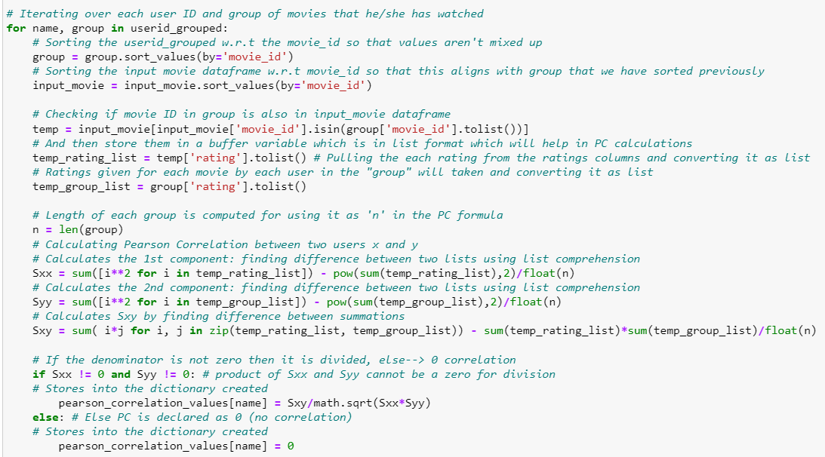
| 34
IMPLEMENTED PEARSON CORRELATION FROM SCRATCH
6
Code block that computes the Pearson Correlation values
Grouping the ratings since that is our primary factor/input for the Pearson Correlation formula
Part 1
PC values are computed and stored inside dict. declared
Part 2
PC values are computed and stored inside dict. declared
RIT | MS Data Science | Fall 2021 | DSCI 633 | Final Project

Slide 35
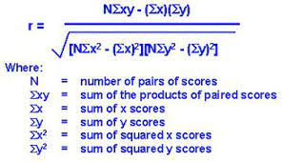
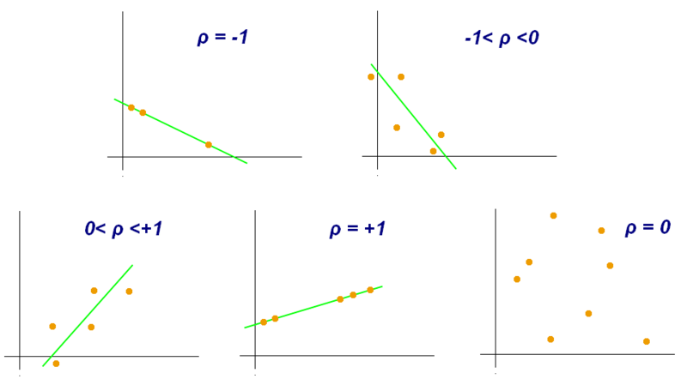
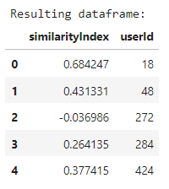
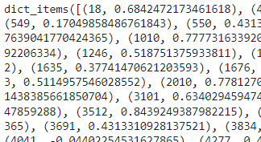
| 35
AGAIN, PC PROVIDES A SAFE WAY TO TAKE A DISTANCE MATRIX AS INPUT
1
2
Reasons
Formula
This finds the similarity between pairs of users
Weighted average of ratings are calculated and multiplied with the similarity so that it gets influences the ratings
3
4
Possibilities
Similarity scores
Dictionary of scores - unsorted
PC* - Pearson correlation coefficient
RIT | MS Data Science | Fall 2021 | DSCI 633 | Final Project

Slide 36




| 36
NEED VALIDATION TO CHECK PERFORMANCE OF THIS USER COLLABORATIVE FILTERING
Weighted ratings are added
Sum of similarity scores
Score with weighted average
✓

Personalised recommendations
“Now we have personalized recommendations our user!”
“How do we validate this result?”
Looks like the recommendations has given us list of movies with Comedy as a the most common genre. We will be able to validate our work qualitatively but not by quantitative measures.
Next Step: Since we have not done any validations on the implementations that we have seen till now, we will perform the validation on both user-user and item-item collaborative filtering as a next step with different implementation.
RIT | MS Data Science | Fall 2021 | DSCI 633 | Final Project

Slide 37
| 37
NEED VALIDATION TO CHECK PERFORMANCE OF THIS USER COLLABORATIVE FILTERING
Weighted ratings are added
Sum of similarity scores
Score with weighted average
✓
Stuck at this point

Personalised recommendations
“Now we have personalized recommendations our user!”
“How do we validate this result?”
Looks like the recommendations has given us list of movies with Comedy as a the most common genre. We will be able to validate our work qualitatively but not by quantitative measures.
Next Step: Since we have not done any validations on the implementations that we have seen till now, we will perform the validation on both user-user and item-item collaborative filtering as a next step with different implementation.
RIT | MS Data Science | Fall 2021 | DSCI 633 | Final Project

Slide 38

| 38
ROOT MEAN SQUARED ERROR USED AS A METRIC FOR VALIDATION
RMSE
.
What is RMSE? Root mean square estimation is an estimate for the average difference between the predicted value and the actual value.
n → Number of estimators
yj → Current estimation
ŷj → average value of the estimations
Why are we using it? Root mean square estimation is used as a protective measure to reduce the individual impact from the errors of each individual measurement, so that no one majorly faulty estimation will skew the result too much.
RIT | MS Data Science | Fall 2021 | DSCI 633 | Final Project

Slide 39



| 39
SIMILARITY MATRIX FOR USER AND ITEM (NEW) BASED
User similarity matrix generated with PC again
Item similarity matrix generated with PC (New)
1
4
Random sample pulled from the 1 million observations to reduce the complexity
Item similarity matrix using pairwise_distances
2
Using Pearson Corr.
Having the test size as 2% of 20,004 random sample data
5
3
Function for calculating RMSE
User similarity matrix using pairwise_distances
User similarity matrix computed in 7.15 seconds:
Using Pearson Corr.
RIT | MS Data Science | Fall 2021 | DSCI 633 | Final Project

Slide 40

Validation Results
Lessons Learned
| 40
ITEM BASED MODEL PERFORMS BETTER THAN USER BASED MODEL
When new user enters the system, we will not be able to recommend movies to him/her
Memory Based Collaborative Model
Root Mean Squared Errors
If new movie without any ratings data is added, the model's performance will be bad
User Based
1416.489
✓
Item Based
1636.638
The performance will be bad with sparse data, meaning it's hard to find users that have rated the same items
RMSE of Item based is 220 more than User based model
It tends to recommend items that are popular
RIT | MS Data Science | Fall 2021 | DSCI 633 | Final Project

Slide 41
| 41
COLLABORATIVE FILTERING IS THE BEST RECOMMENDATION ENGINE
Conclusion
Recommendation
Overall Learnings
Next Step
RMSE for the User based collaborative filtering is low when compared
Collaborative filtering approach provides the best user experience as it is more personalized. And specifically, user based implementation is better because of its Greater diversity
Searched and pre-processed datasets
Performed Exploratory Data Analysis on clean data
Defined the problem statement based on EDA
Understood Content based and Memory based Collaborative Rec. Sys.
Implemented above models by Python code and its libraries
Implementing Collaborative filtering with model based approach
Implementing Collaborative filtering with Neural Networks
RIT | MS Data Science | Fall 2021 | DSCI 633 | Final Project

Slide 42
| 42
END OF FINAL PROJECT
Thank You
- Amit Dilip Kini
Ashini Anantharaman
Niranjana Sathish Avilery
Praveen Chandrasekaran
Vigneshwaran Ravichandran
RIT | MS Data Science | Fall 2021 | DSCI 633 | Final Project

